Slide 1

DATA-DRIVEN INSIGHTS FOR CHINOOK’S PHYSICAL MUSIC MARKET STRATEGY
Rohan Gupta
10th January 2026

Slide 2

PROBLEM STATEMENT
Chinook wants to analyze the music sales data for company strategy in physical stores:
Which country has large customer base.
Which country produce high revenue and basket size.
What is trend of sales over the years.
Customer churn rate over the years.
What are the top genres according to sales performance per country.
Product recommendation and cross selling initiatives.
Customer behavior across different segments like new vs old, frequency & value, country, active & churned.

Slide 3
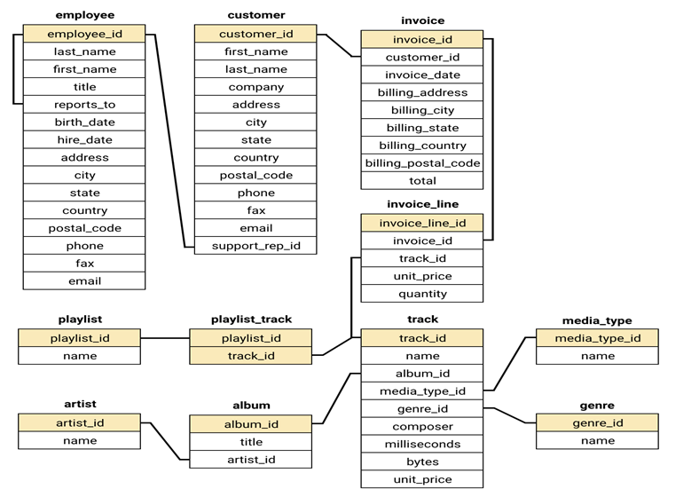
DATABASE SCHEMA

Slide 4
DATASET OVERVIEW
Customer: it contains details about customer like their name, address, country, contact info.
Invoice: it contains info about the sale like customer_id, date of purchase, billing address, city, state, country, total amount.
Invoice line: it contains each item bought in an invoice like track, unit price, quantity.
Track: it contains info about the item bought like album it belongs to, media type, genre, composer, byte, milliseconds, unit price.
Albums, artist, genre, media type: it contains their respective details like their id, name.
Playlist, playlist track: it contains playlist name, id and track in that playlist.
Employee: it contains details about employee in the company and which employee is a support rep for customer.
These are all the tables, some of them has duplicates row, some has missing values, some of the columns which should be present.

Slide 5
CLEANING THE DATASET
There are duplicates in the invoice line table as the same customer has same value for every column except invoice line id.
Which shows that it is duplicate because if the customer is buying same thing, then quantity column should have increased and not new row added.
There are also duplicates in playlist table, so they are removed too.
There are missing values in many tables, but we won’t be removing them as they are mostly optional column or columns where we can’t fill them with anything as that will give us misleading result.
We also added the ReleaseYear column in album table for future analysis but for now their default value will be null.

Slide 6
CUSTOMER COUNT PER COUNTRY
INSIGHTS
From this we see that USA, Canada, France, Brazil, Germany are top 5 countries with highest count.
Most of the countries have only 1 customer.
Countries which has 2-3 customers has potential to increase the count.

Slide 7
AVERAGE BASKET SIZE, AMOUNT SPENT PER CUSTOMER
INSIGHTS
From this we see that countries with high number of customers have average size and spending compared to other countries.
Ireland and Czech Republic has highest number which shows their willingness to spend big so they can be provided with premium options.
Countries with low spending like Denmark, Argentina has high chance of churn.

Slide 8
TOP 10 COUNTRIES PER TOTAL REVENUE
INSIGHTS
From here we see that revenue has direct relation with number of invoices.
USA has highest revenue which means that their market has more opportunities.
Countries around 40-70 total invoices has more potential to offer loyalty program, increasing visits by providing discounts.

Slide 9
GENRE REVENUE IN USA
INSIGHTS
We see that Rock genre has generated highest revenue with big gap between it and other genres.
Metal, Alternative & Punk are the next highest to generate revenue.
Alternatives, Blues, R&B/Soul these genres are after the 2nd group.
This shows that customer buy Rock as 1st choice, 2nd group as next choice, 3rd group as next choice.
This is mostly true for many customers in their visits.

Slide 10
TOP GENRE PER COUNTRY
INSIGHTS
This shows that like USA most of the other countries has Rock as their top genre.
Argentina is the only one which has Alternative & Punk as top genre.
From this Canada has highest revenue with Brazil, France, Germany next in line.
This will help in recommendation of tracks or albums for stores in countries.

Slide 11
TREND IN CUSTOMER PURCHASING BEHAVIOR
Sales Count trend
INSIGHTS
Sales volume shows clear seasonality, with noticeable peaks around March–April and August–September across most years.
2019 records the highest and most consistent sales counts, indicating stronger customer demand or improved sales strategy compared to other years.
End-of-year sales (November–December) fluctuate significantly, suggesting opportunities for better year-end promotions or inventory planning.

Slide 12
Revenue Generated Trend
INSIGHTS
Revenue generally peaks mid-year (June–September), even when sales count is moderate, indicating higher-value transactions during this period
2018 shows sharp revenue volatility, suggesting inconsistent pricing, discounting, or changes in customer purchasing behavior.
2020 demonstrates a recovery and upward trend toward year-end, reflecting improved revenue generation despite earlier fluctuations.

Slide 13
FREQUENTLY PURCHASED TOGETHER ITEMS -
Genre pairs
INSIGHTS
Rock appears most frequently across paired purchases.
Rock appears most frequently across paired purchases.
Indicates strong cross-genre buying behavior centered around Rock.

Slide 14
Artist Pairs
INSIGHTS
Green Day and Queen appear repeatedly in popular artist pairings
High co-purchase frequency suggests strong fan overlap.
High co-purchase frequency suggests strong fan overlap

Slide 15
Album Pairs
INSIGHTS
Mezmerize is the most frequently co-purchased album.
Classic and greatest-hits albums show strong group purchases
Album bundles can increase cart value.

Slide 16
CHURN RATE PER YEAR
INSIGHTS
We see that 2018 and 2019 has higher rate of churned customers compared to 2020.
The spike in 2019 can be due to increased competition, pricing issues but that is mostly handled for 2020 leading to lower churn rate.

Slide 17
CHURN RATE PER COUNTRY
INSIGHTS
Countries with 100% churn rate are likely due to small customer base.
Focus on countries with moderate churn rate like USA, Canada, Germany as they have potential to improve retention.

Slide 18
PURCHASING BEHAVIOR B/W NEW AND LONG-TERM CUSTOMERS
INSIGHTS
New customers exhibit higher purchase frequency and slightly larger basket sizes during their first year, indicating strong initial engagement.
Over time, customers transition into more stable but less frequent purchasing behaviour, with slightly reduced spending per transaction.
Old customers have low engagement, are habit driven, selective
This suggests that retention strategies should focus on sustaining early engagement momentum through loyalty programs and personalized offers.

Slide 19
CUSTOMER RISK PROFILING
INSIGHTS
Customers with high frequency has significantly low churn customers, it means that high engagement is the way to retention.
Low frequency and low value has unexpectedly low churn which shows that they are casual customers.
Low frequency and high value has highest churn customers which shows that they might be customers who buys in bulk.
So it shows customer with low frequency has higher chance of churn.

Slide 20
CUSTOMER LIFETIME VALUE (CLV)
INSIGHTS
Results indicate that high-frequency exhibit significantly higher CLV.
While churned customers generate lower lifetime revenue, reinforcing the importance of engagement-driven retention strategies

Slide 21
CONCLUSION
Based on the analysis we see that Rock, metal, A&P are most famous genres.
USA, Brazil, Canada, France, Germany have the highest revenue.
Low frequency customers tend to churn more.
Long term customers has low frequency compared to new customers but are more stable.
CLV of high frequency and active customers is higher.
Sales get positive feedback in mid-year.
There are groups of genre, artist that people usually buy tracks off.
Customers bought tracks most that are in MPEG audio file.

Slide 22
RECOMMENDATIONS
Company should sell tracks of Rock, Metal, Alternative & punk genres more.
It should offer loyalty program to countries with high revenue, frequency, stable or low churn rate.
There should be more intensive strategy to keep customer retention for customers in their 1st year as they tend to buy more.
Tracks should be sold in MPEG file format.
There should be sales, events in mid-year, end of year to get a seasonal effect.
Targeting strategies focused on increasing customer frequency may yield better retention results.
Do not invest heavily in countries with less number of customers and low revenue too.

